Slide 1
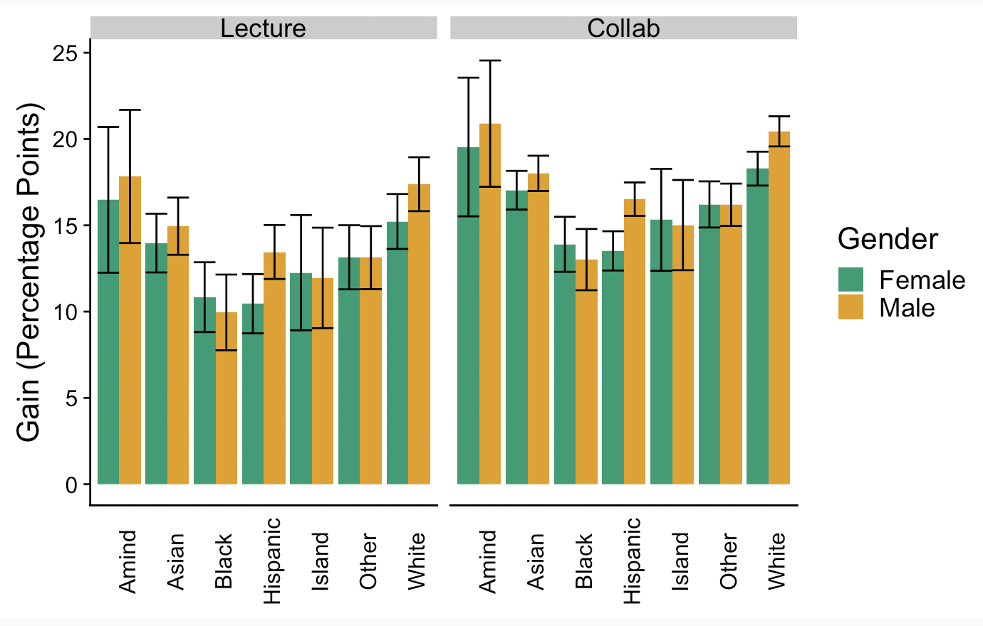
I just put this here for the labels

Slide 2
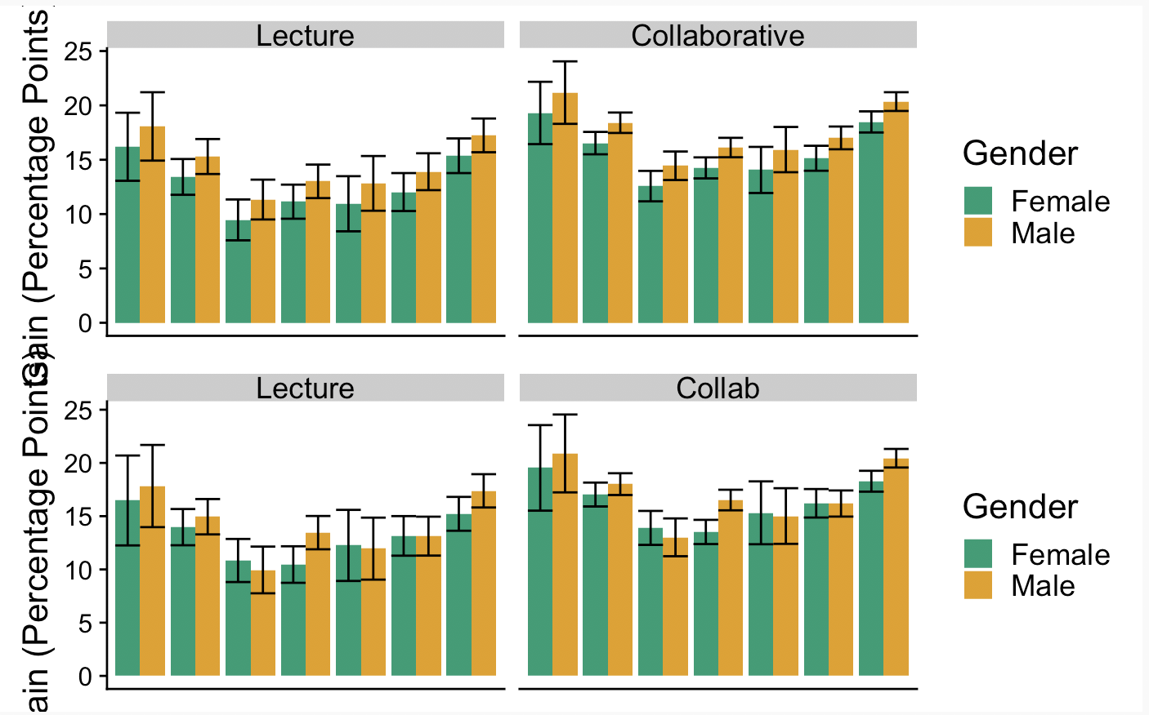
Differences
For the third column (Black) women are higher than men in interaction but neither difference is statistically significant.
Islander and Other are also similar in the interaction model but again the differences aren’t statistically significant.
Gender differences are consistent for the largest groups – white, hispanic, and asian, though smaller for asian
I’m not sure what to make of the amind (American Indian)
Top is no interaction
Bottom is interaction

Slide 3
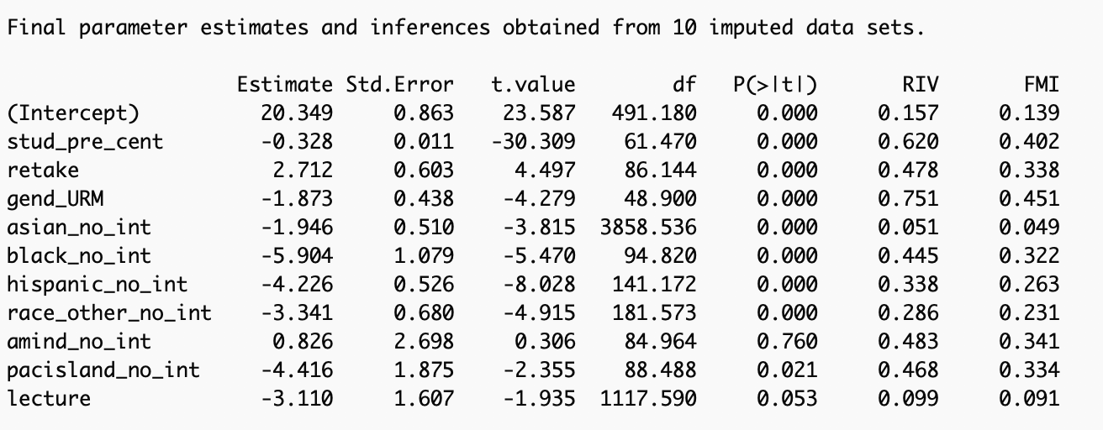
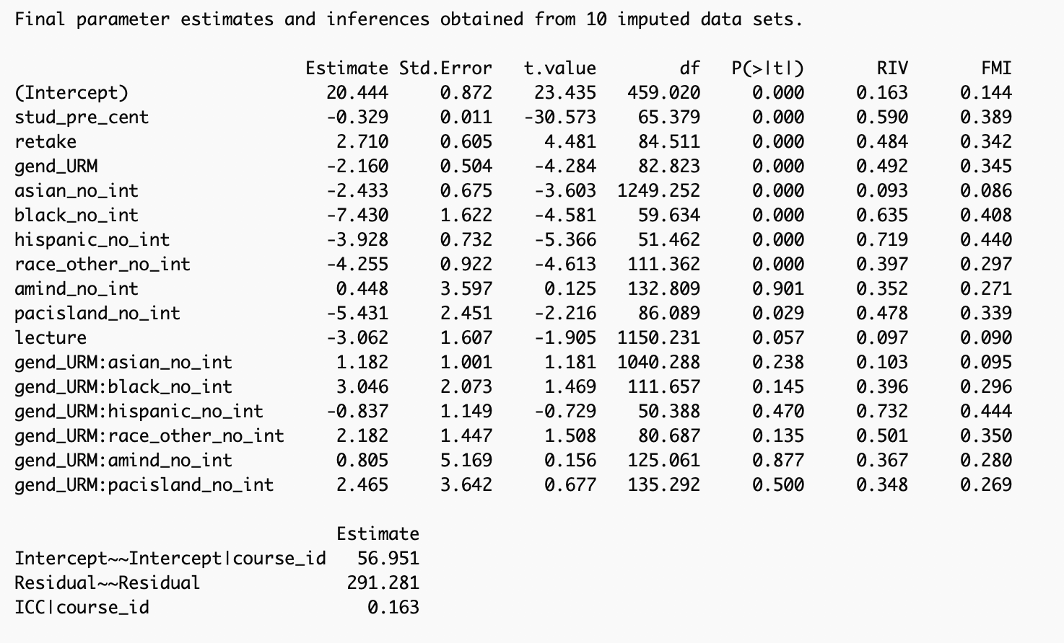

Slide 4
Big takeaway
Based on our models it looks like there is a statistically significant and meaningful gender difference for
  White
  Hispanic
There is a not statistically significant gender difference for
  Black
  American Indian
  Pacific Islander
  Asian – But this one is a little bit different than the others. It is also the only one that is relatively large

Slide 5
Analysis 1/28

Slide 6
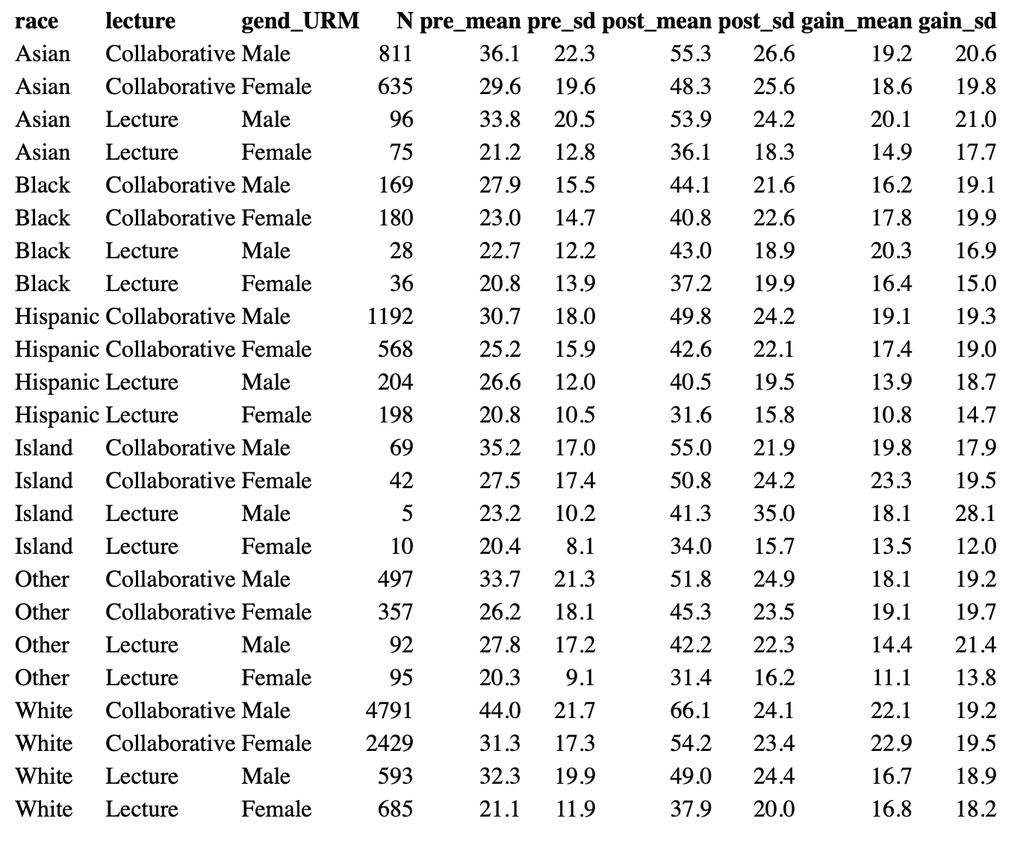
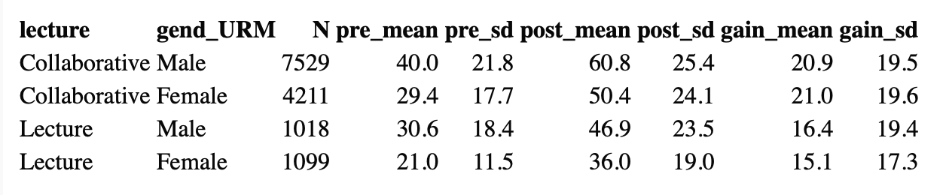

Slide 7
8 gend*AHBOP
9 gend * AHBOP + Lect
10 gend * Lect + AHBOP
11 gend * lect * AHBOP

Slide 8
Notes
Confidently say that white students have larger gains than any other group when controlling for pretest
We can only say there is a gender difference for White and Hispanic students with confidence
Collaborative only increases learning gains 3 points

Slide 9
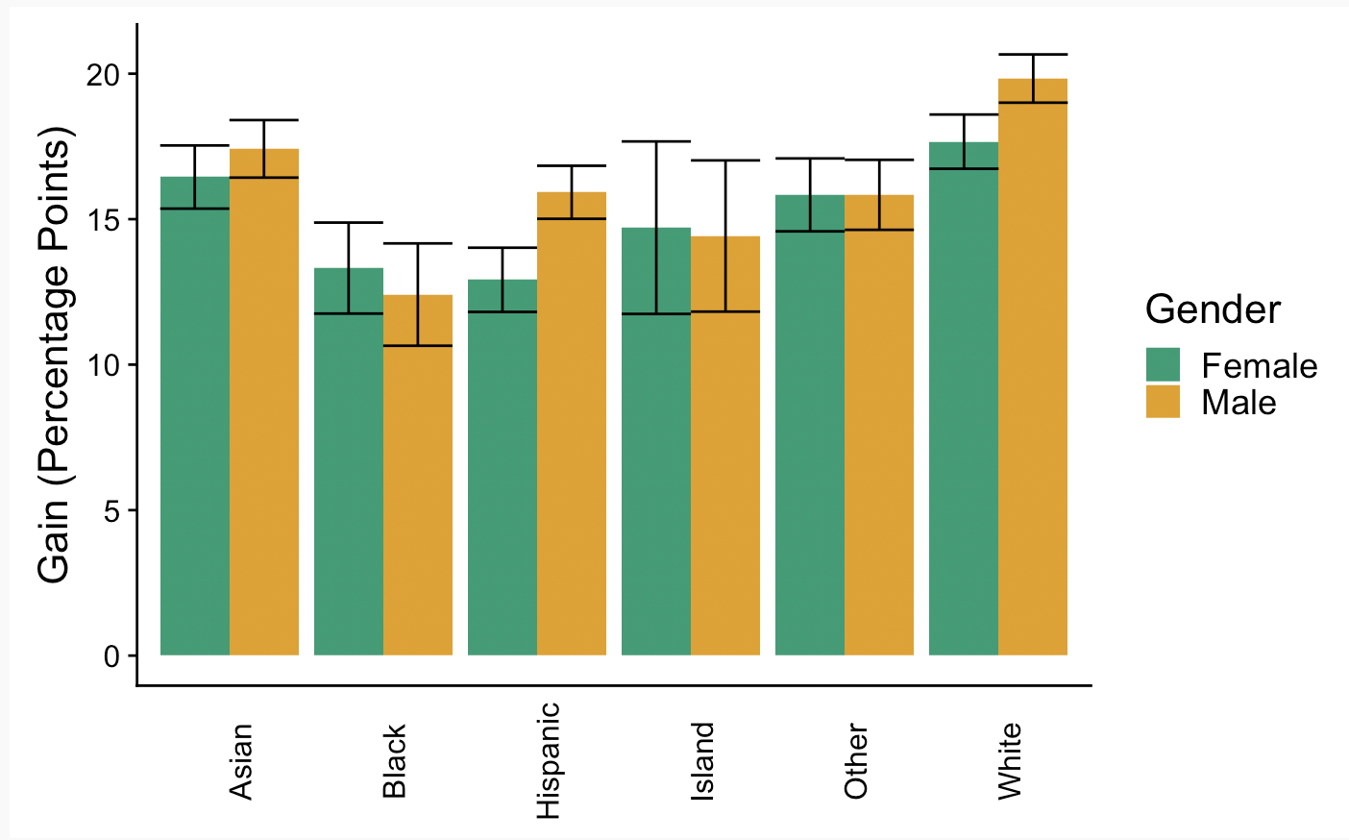
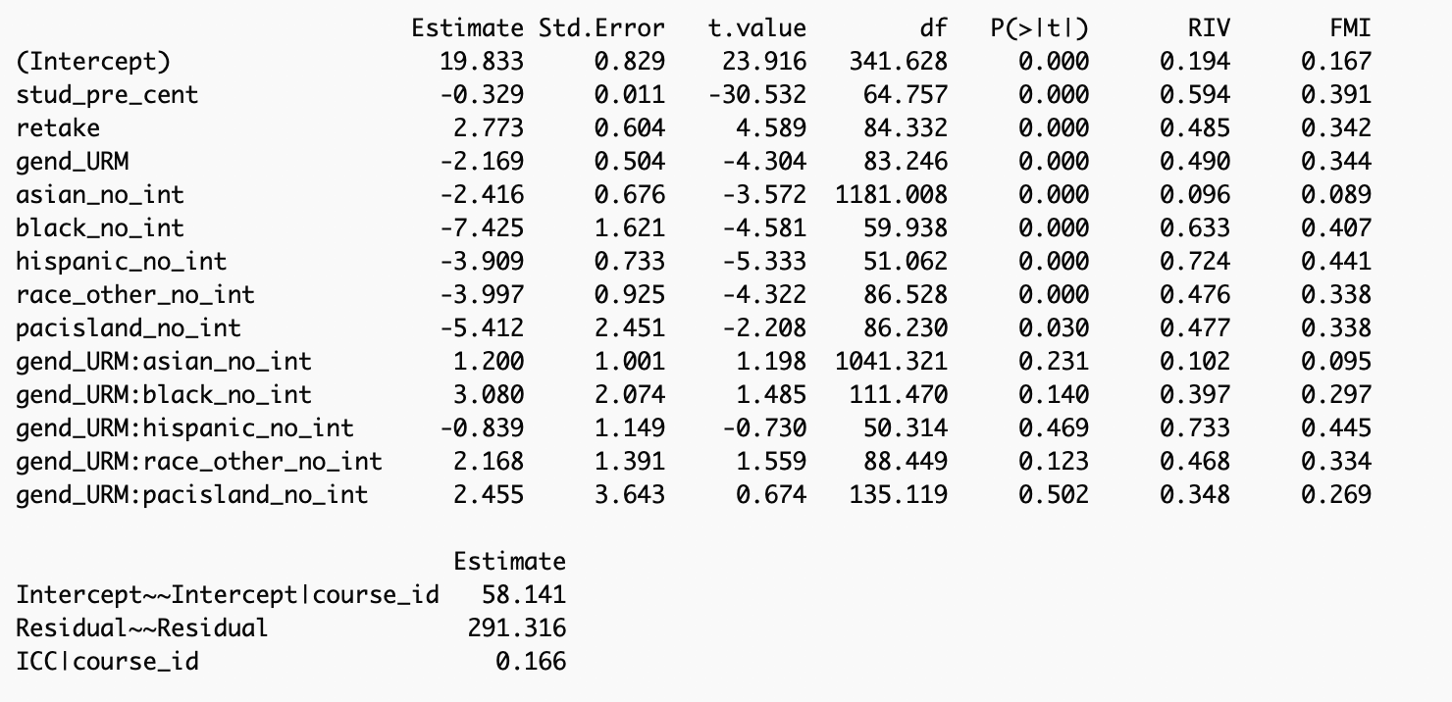
8 gend*AHBOP. No lecture
None of the interactions are SS. Black and other are close, asian is a little close. Really this just shows that we should only be confident about gender differences for White and Hispanic students

Slide 10
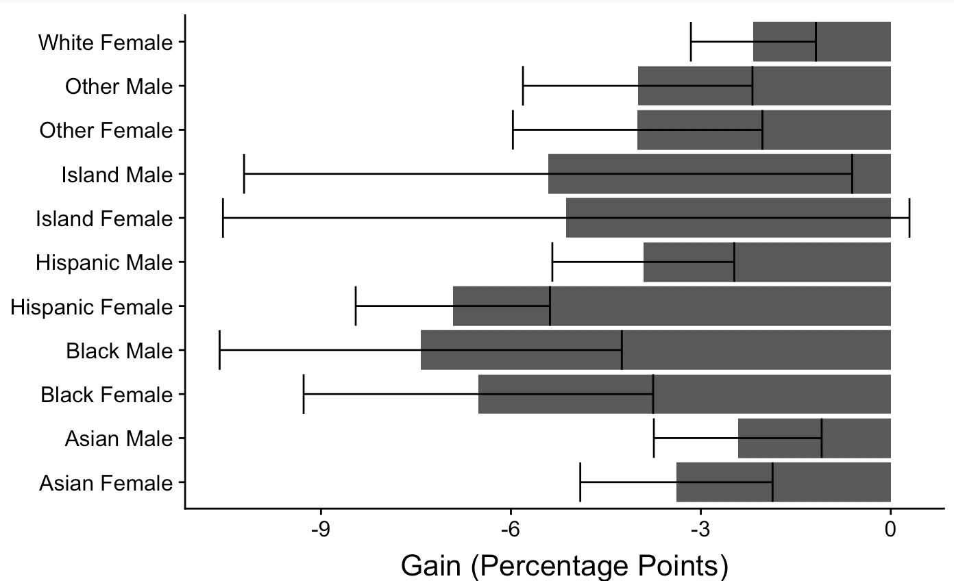
Differences

Slide 11
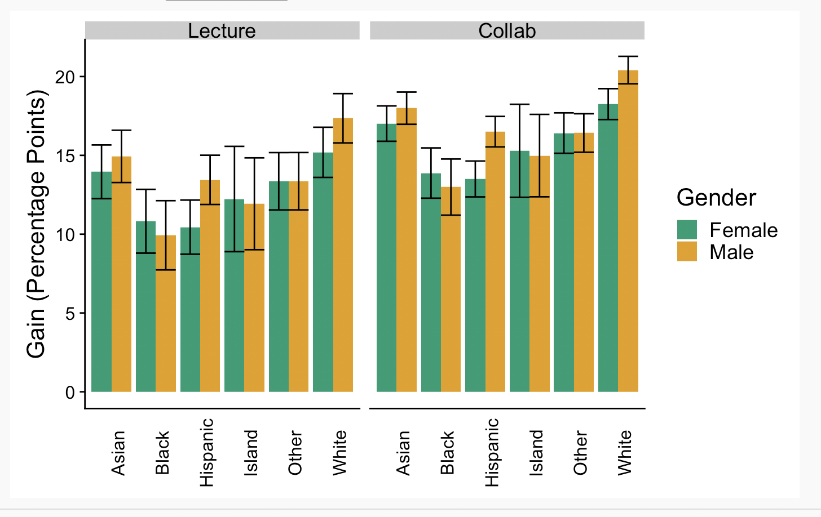
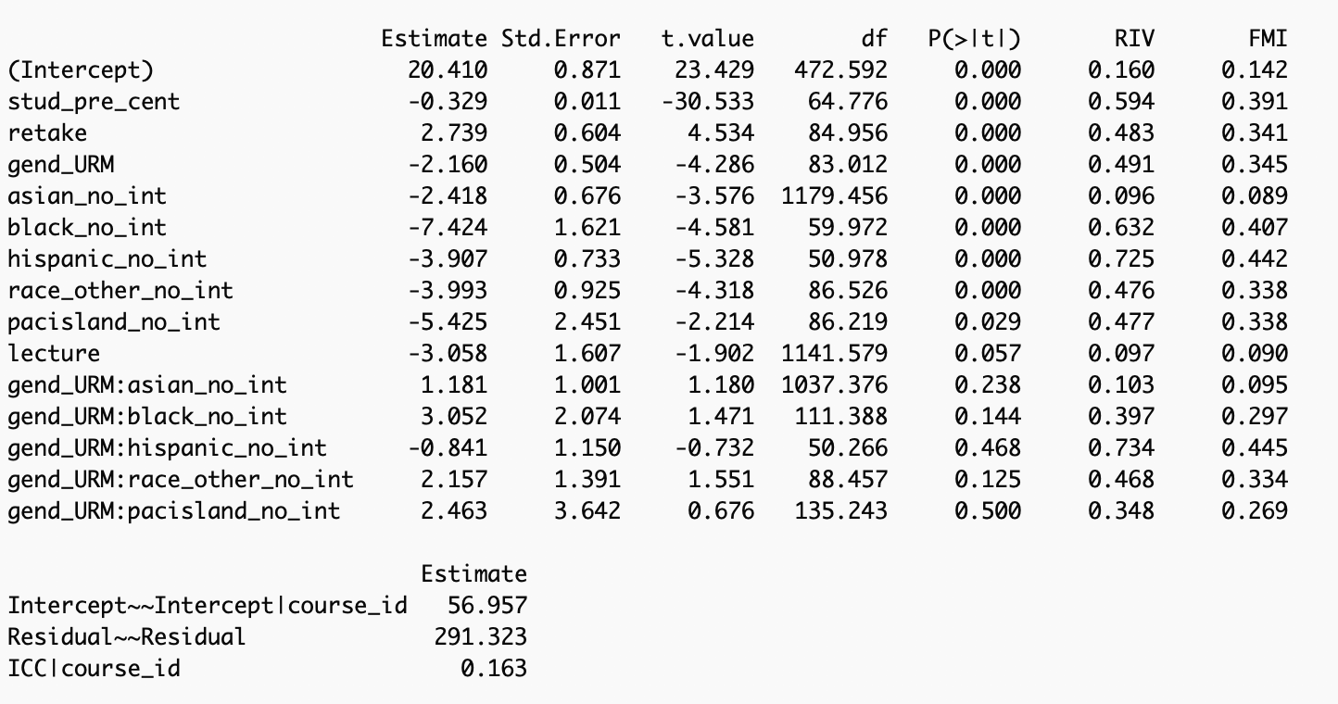
9 gend*ABHOP + Lect
This basically looks the exact same. The lecture

Slide 12
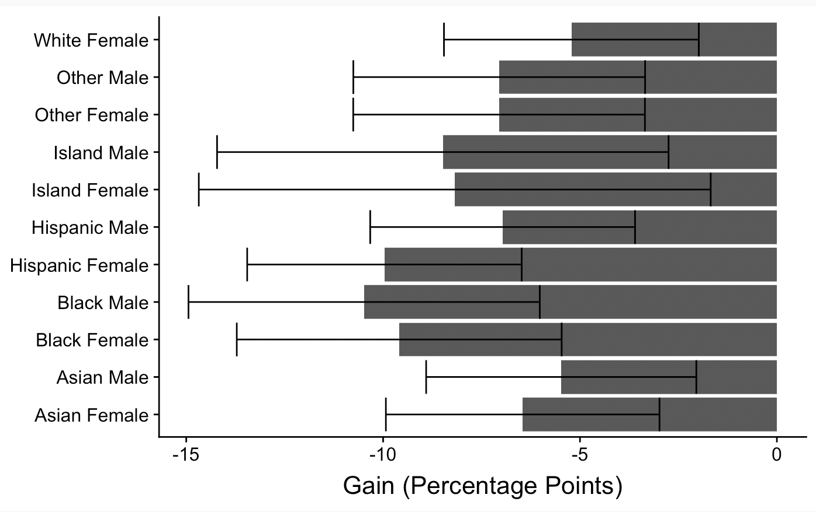

Slide 13
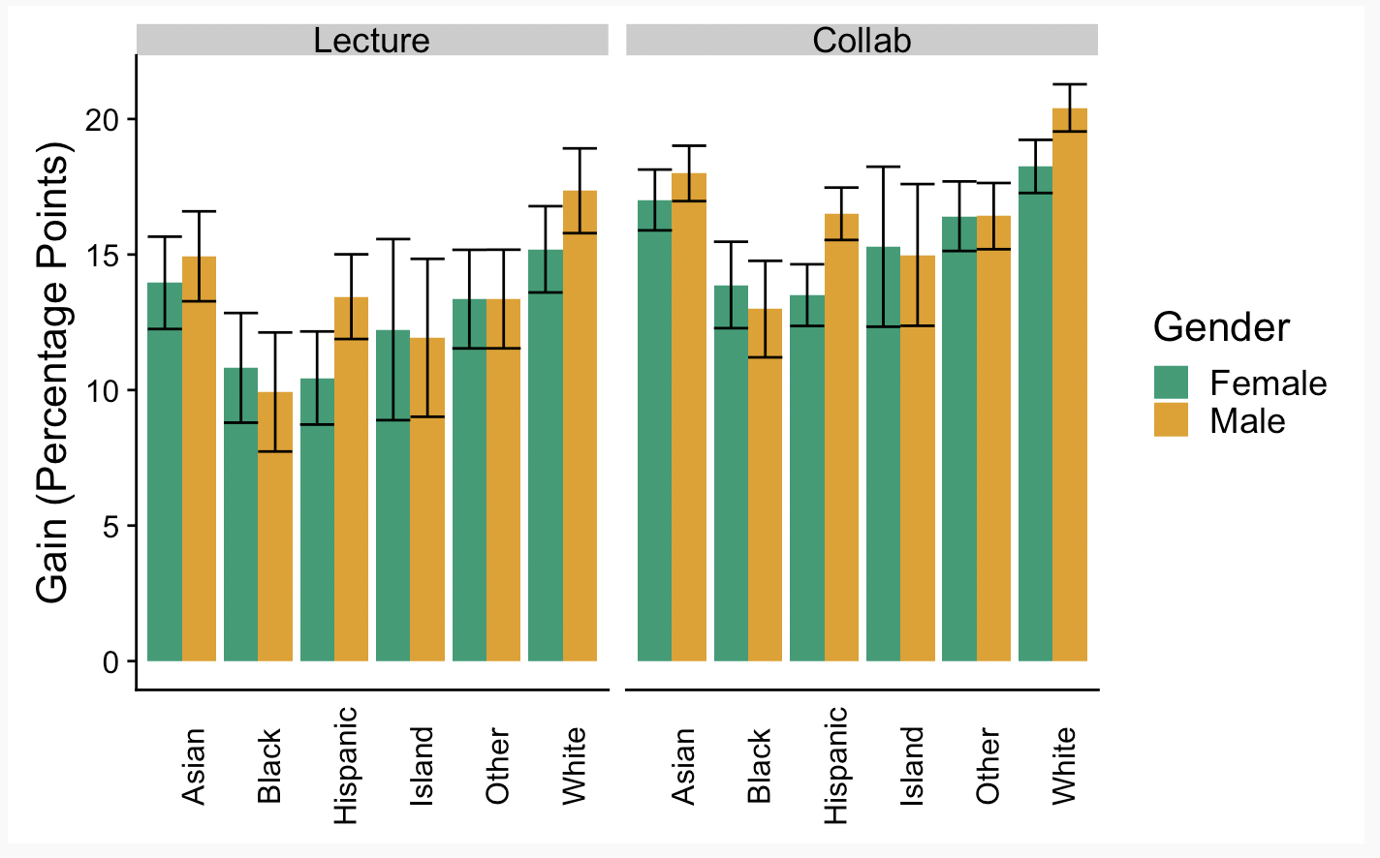
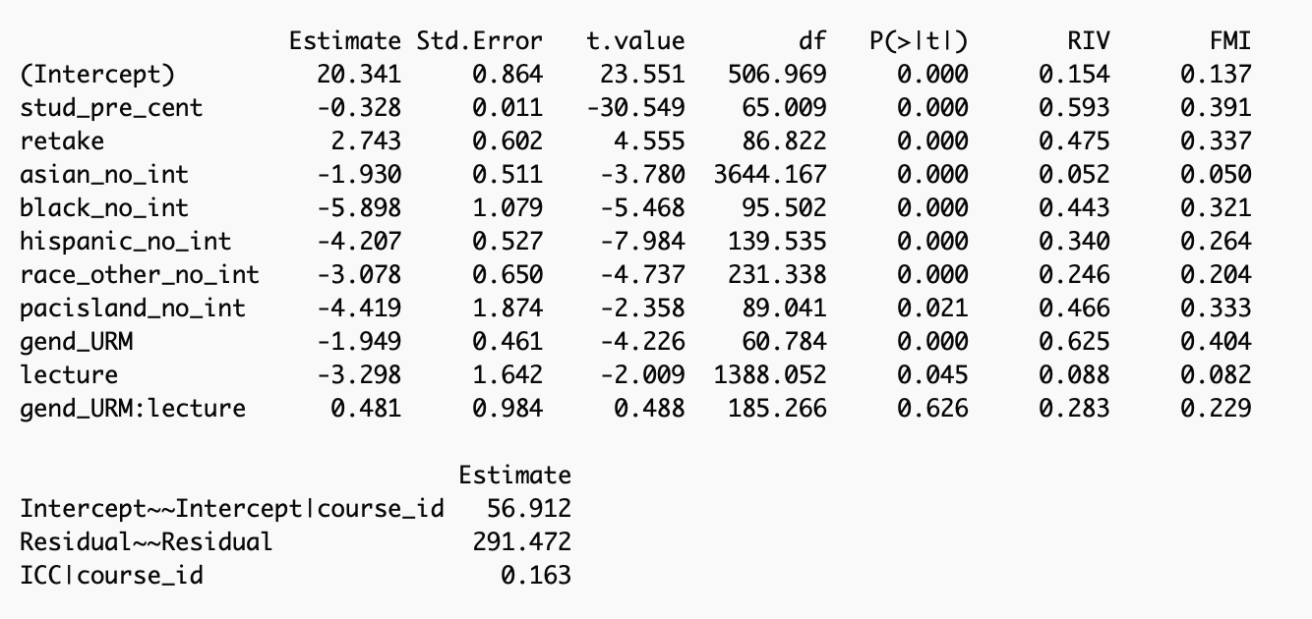
10 gend*lect + ABHOP
No interaction between gender and lecture. Small coefficient, large p-value

Slide 14
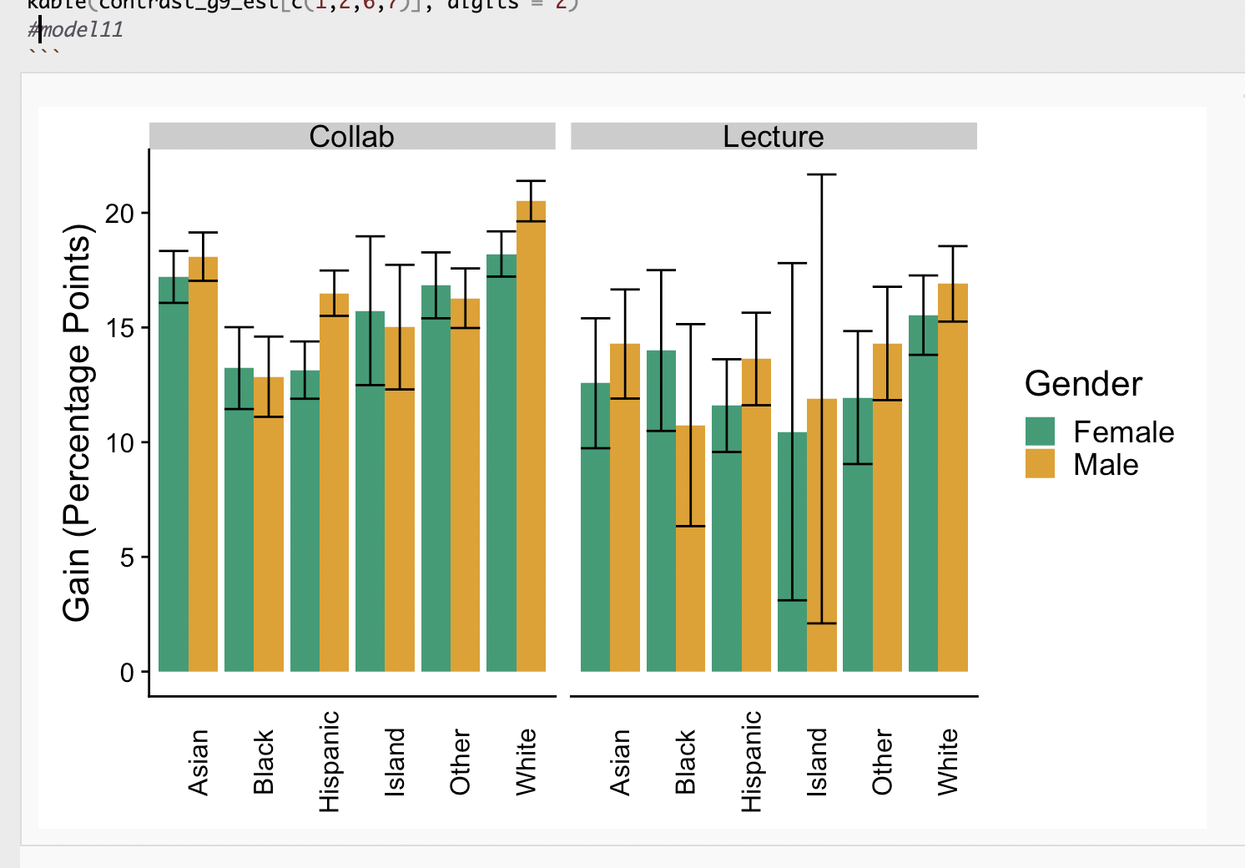
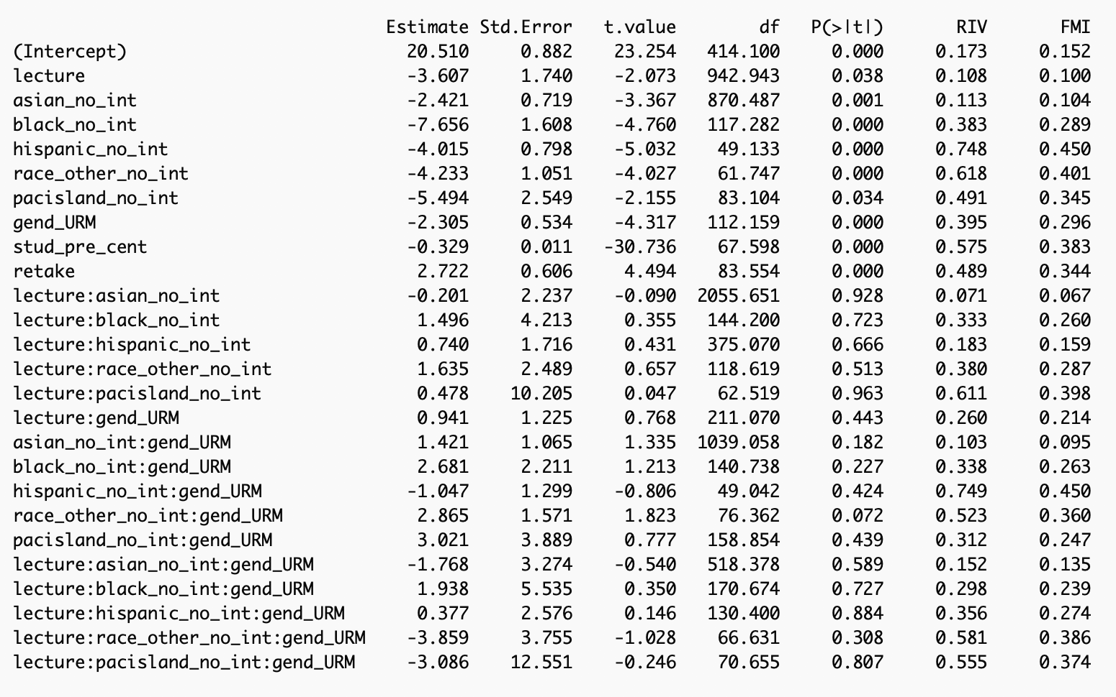
11 gend * AHZBOP * Lect
The three way interaction makes this hard to follow

Slide 15
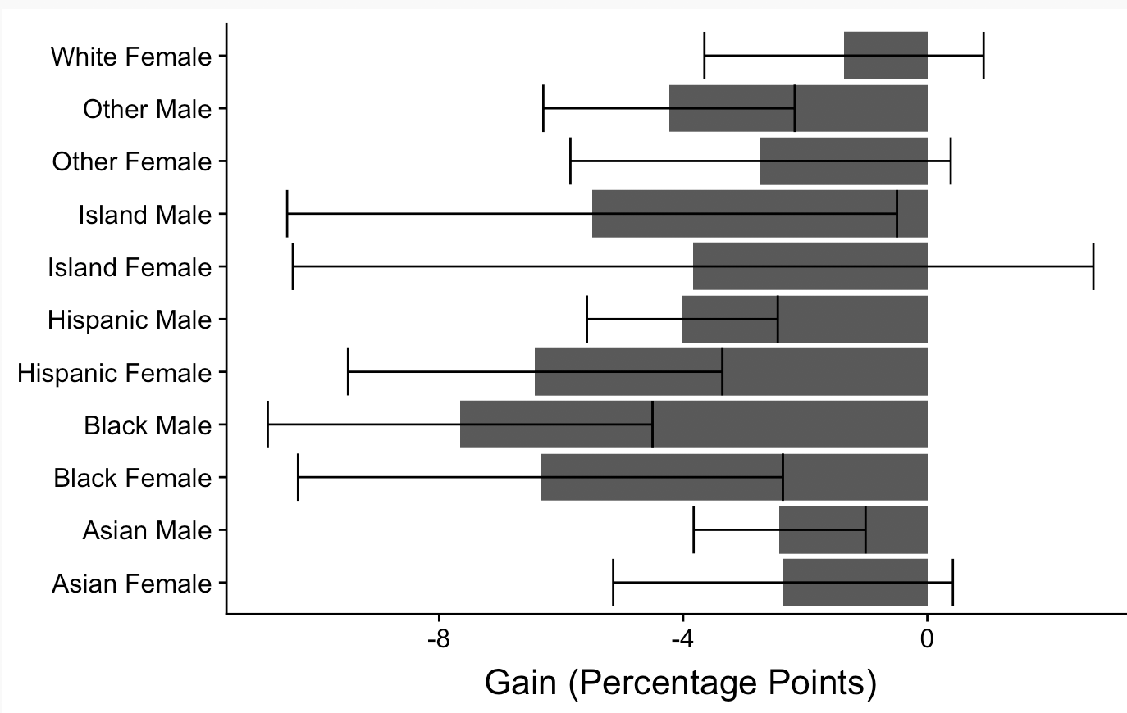
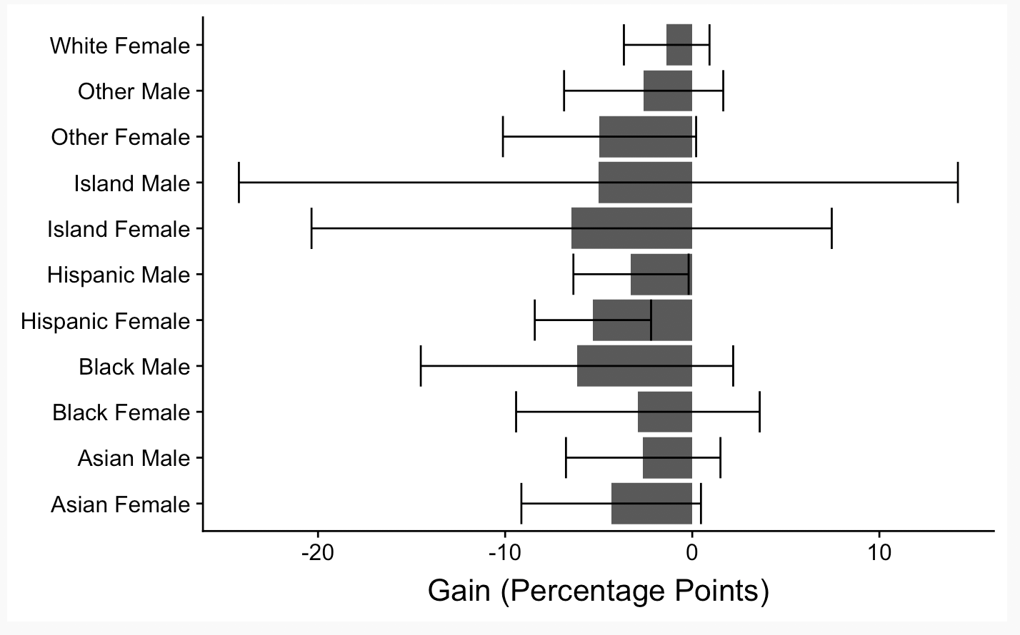
Collaborative
Lecture

Slide 16
Comparing 8 and 11 for
These two models basically give us the exact same values. The lecture model is a bit different but it has large error bars.

